Slide 1


Pension Management System
Done by:-dintyala navya sree
EmpID:- 2184020

Slide 2
Table of Contents
1.Introduction
2.Functionality
3. Methods
4.Architecture
5.Procedure
6.Dockerization
7.Requirements
8.Advantages
9.Conclusion

Slide 3
Introduction​
A pension is a retirement plan that provides a monthly income.
The employer bears all of the risk and responsibility for funding the plan
The purpose of this application is to build a system that gives employees or employer various functionality for their pension management system.
This application includes various functions like create applicant , check status , check balance ,check application, Issue pension ,load pension using spring boot framework

Slide 4
Functionality​
1.Create applicant (Add Pensioner)
2. View Employee Records
By check Applicant
3. Calculate Pension
By using load Pension
By using issue pension

Slide 5
Methods​
Create Applicant
Check Status(by id)
Check Balance(by id)
Check Application(by id)
Issue Pension
Load Pension

Slide 6
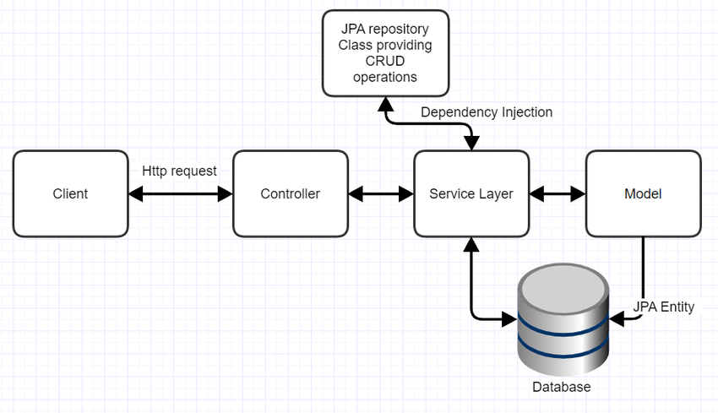
Architecture​

Slide 7
Procedure​
Create Application structure using Spring Intillizer by adding requirement, dependency and versions.
Write required classes and methods.
We have to install all the dependancies by doing mvn clean install.
Start mysql image in docker using docker-compose -f dockercompose-mysql.yml up –d
Then we need to run the application using the command mvn spring-boot:run
Now enter the data in postman using localhost:/port no/method name

Slide 8

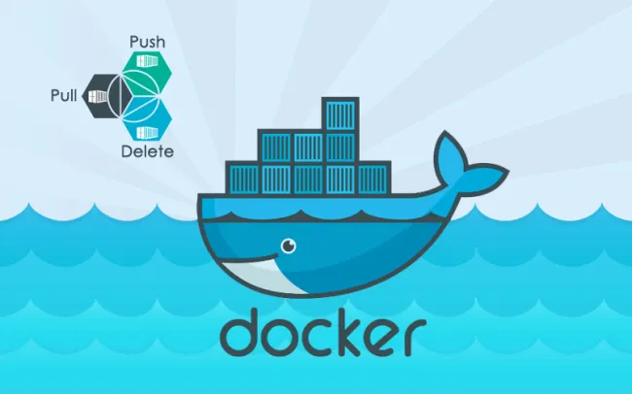



Dockerization​
Docker is an open source platform that enables developers to build, deploy, run, update and manage containers.
Docker containers can run anywhere, However, Windows images can run only on Windows hosts and Linux images can run on Linux hosts

Slide 9
Steps of Dockerization
To dockerization we need Dockerfile in our application.
After that start docker from docker desktop
Run command mvn install dockerfile:build
Check docker desktop weather image is created or not
Push to docker hub from docker desktop.

Slide 10
Requirements​
Software Requirements
Java Spring-boot
Postman
MySQL
Maven Docker
IDE(IntelliJ/Eclipse)
Hardware Requirements :
Windows OS
Internet connection

Slide 11
Advantages​
Easy to use/User friendly
database helps to minimize data redundancy.
User can easily perform operations like add, update, search, delete the data from database.

Slide 12
Conclusion​
This Pension Management System is designed to manage pension activities. It is beneficial to a pension management organization as well as employee.
The basic aim of carrying out this project is to develop a solution that will largely, help in the aspect of pension management which would help eliminate the problems associated with the manual process

Slide 13


